Slide 1


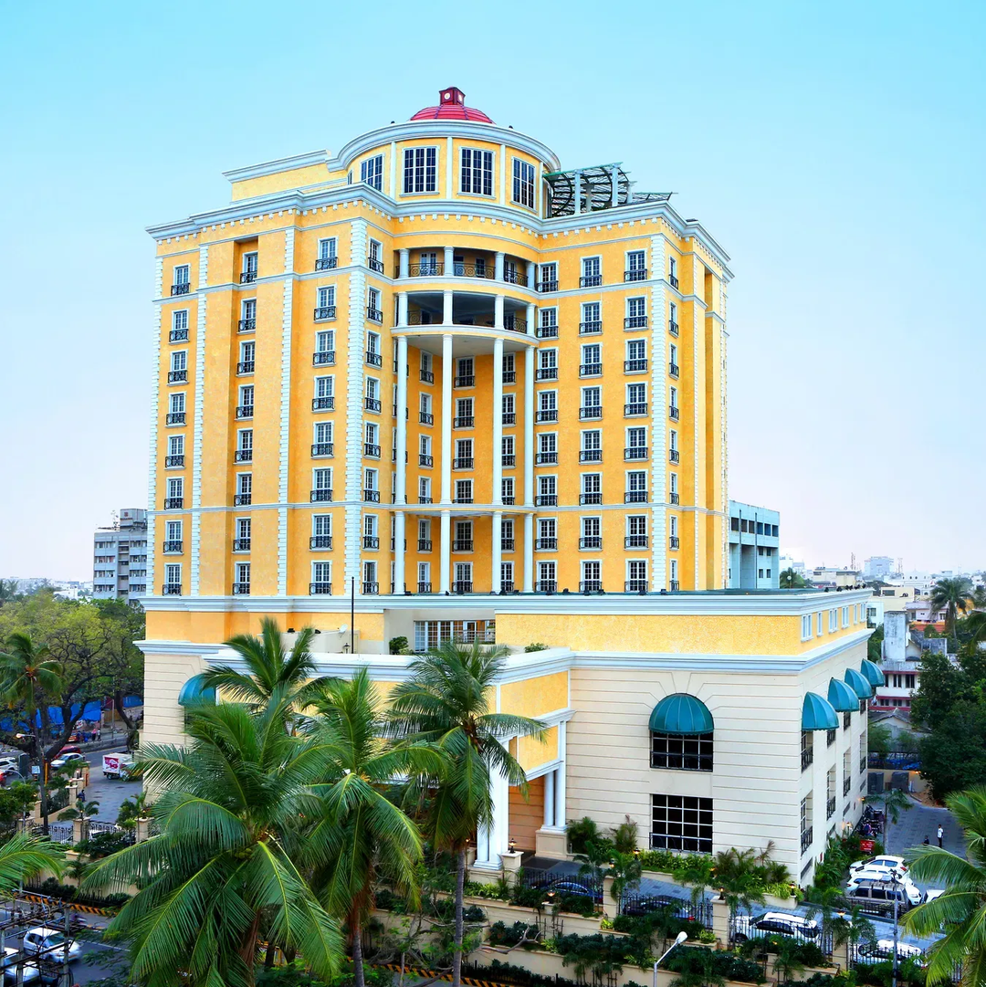
INFOSYS SPRINGBOARD
SUMMARY
GUEST
CANCELLATION
REVENUE
HOTEL REVENUE PERFORMANCE ANALYSIS
This project presents a comprehensive analytical study of hotel revenue performance using Power BI. The dashboard evaluates key performance indicators such as Total Revenue, ADR, RevPAR, Occupancy Rate, Cancellation Rate, Seasonal Trends, and Booking Channel distribution to support strategic pricing and revenue optimization decisions.
PROJECT OVERVIEW
TEAM MEMBERS :
DIMPLE SHARMA
KARAN SINGH
DIVYA V
GUIDED BY :
KALAIVANI A

Slide 2

PROJECT STATEMENT
Hotels generate large volumes of booking, customer, and room data across multiple branches and channels.
However, without a structured analytical system, management struggles to monitor occupancy rates, ADR, RevPAR, guest segmentation, cancellation trends, and seasonal performance effectively.
This project, AI-Driven Revenue Analysis for Hotels, aims to build an interactive Power BI dashboard that integrates booking, customer, and room data to analyze revenue performance, forecast occupancy, evaluate cancellation impact, and support strategic pricing and upselling decisions.

Slide 3
OBJECTIVES
1
Analyze overall hotel revenue performance using interactive Power BI visuals
4
Examine booking duration patterns and cancellation impact
2
5
Monitor occupancy rate and room utilization efficiency
Compare room category performance and regional base pricing trends
3
6
Support data-driven revenue optimization and strategic decision-making
Evaluate pricing performance through ADR and RevPAR analysis

Slide 4
M1
M2
M3
M4
M5
DATA MODELING AND INGESTION
OCCUPANCY AND REVENUE METRICS
GUEST ANALYSIS MODULE
FORECASTING AND CANCELLATION TRENDS
REVENUE STRATEGY DASHBOARD

Slide 5




REQUIREMENT ANALYSIS
MICROSOFT EXCEL
Data Cleaning and Preprocessing
CHROME
Data Sourcing and Resources
POWER BI
Dashboard Creation and Development
MICROSOFT WORD
Documentation and Reporting

Slide 6
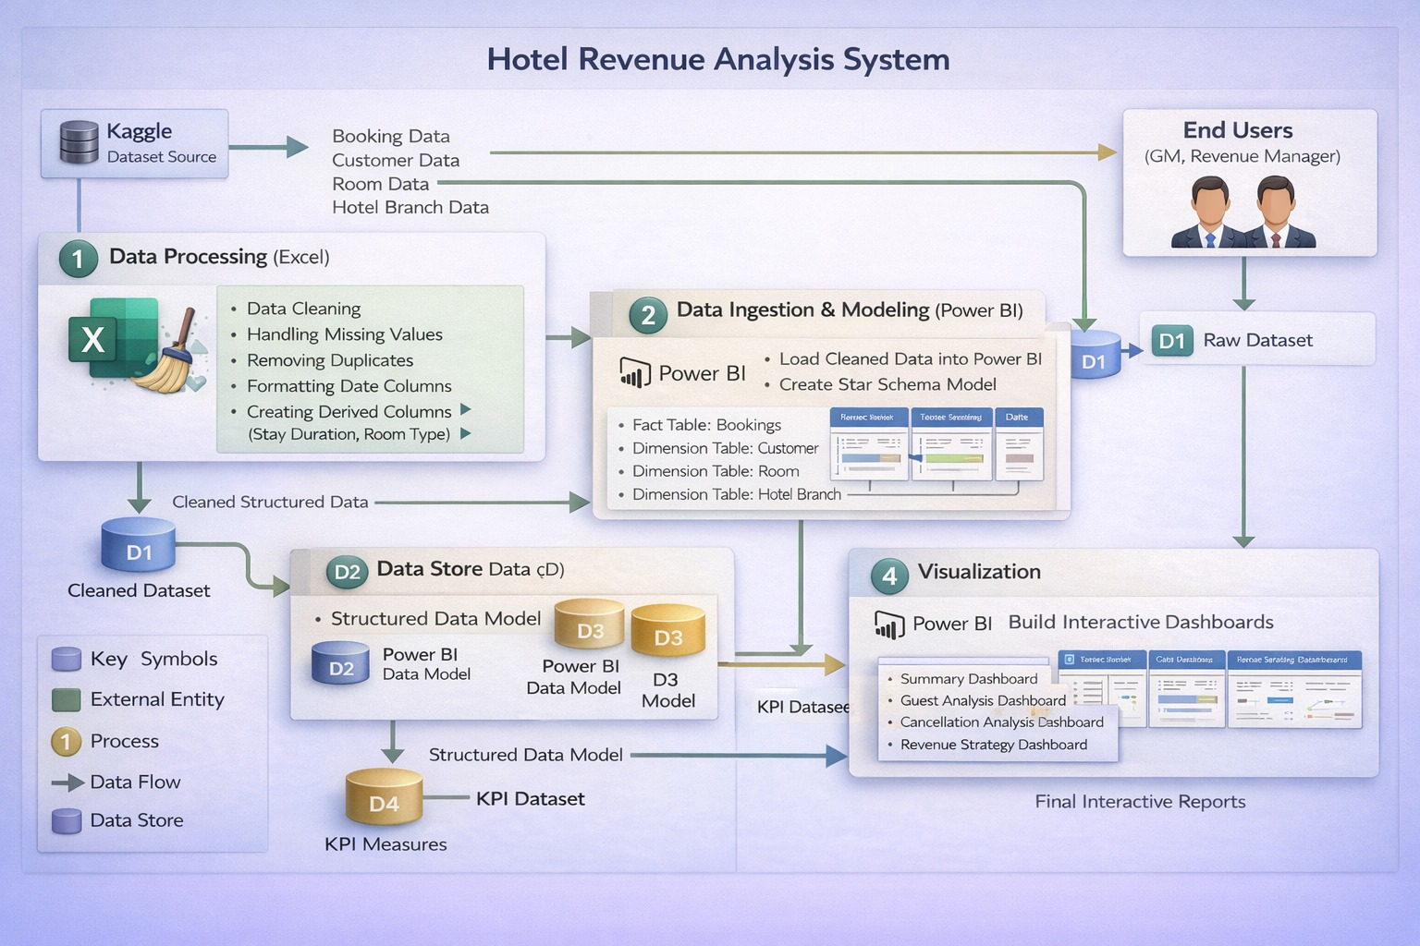
DATA FLOW DIAGRAM

Slide 7
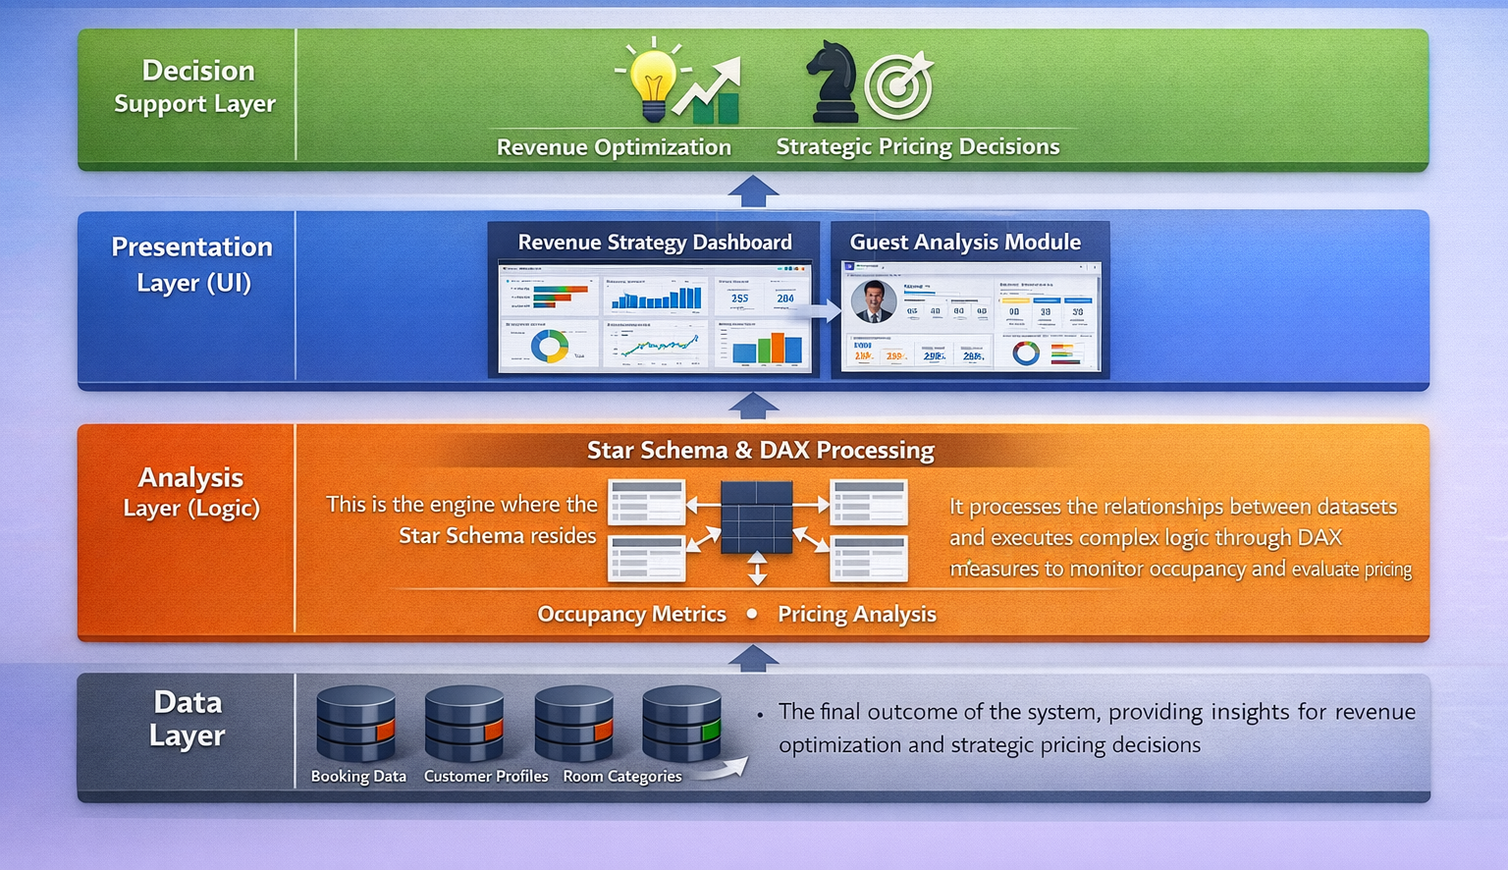
SYSTEM ARCHITECTURE

Slide 8
DATASET DESCRIPTION
📊Booking Data
Booking ID • Check-in • Check-out • Channel • Total Amount • Nights
👤Customer Data
Customer ID • Nationality • Guest Type • Stay Purpose
🛏 Room Data
Room ID • Room Type • Category • Total Rooms
🏨Hotel Branch Data
Hotel ID • City • Region • Hotel Name
📅Date Table
Year • Quarter • Month • Season
These datasets are loaded into Power BI using structured data ingestion techniques

Slide 9
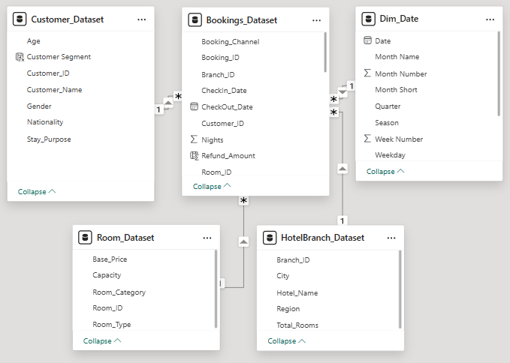
DATA MODELING AND INGESTION
• Collection of booking, customer, room, hotel, and date datasets
• Data cleaning and preprocessing using Microsoft Excel
• Loading structured and prepared data into Power BI
• Implementation of Star Schema model with proper relationships
• Bookings as Fact Table and Customer, Room, Hotel, Date as Dimension Tables
• Creation of calculated columns to ensure accurate analysis and optimized performance

Slide 10
DAX MEASURES
Total Revenue
Total Revenue = CALCULATE(SUM(Bookings_Dataset[Total_Amount]), Bookings_Dataset[Status] IN {"Completed","NoShow"})
Cancelled Bookings
Cancelled Booking = CALCULATE(COUNT(Bookings_Dataset[Booking_ID]),Bookings_ Dataset[Status] = "Cancelled")
ADR(Average Daily Rate)
ADR = DIVIDE([Total Revenue],[Room Nights Sold])
OCCUPANCY RATE %
Occupancy % = DIVIDE([Room Nights Sold],[Total Rooms] * [Total Days]) * 100
BOOKING COUNT
Booking Count = COUNT(Bookings_Dataset[Booking_ID])

Slide 11
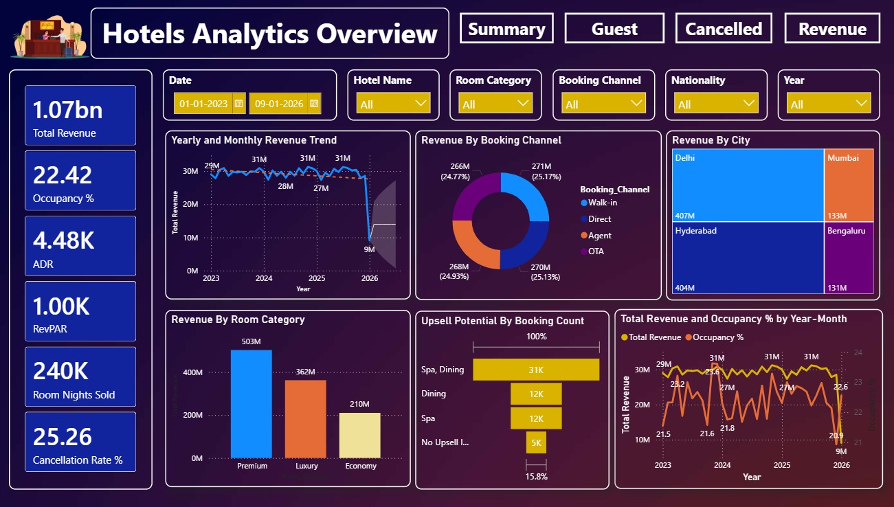
OCCUPANCY AND REVENUE METRICS
• Analysis of Occupancy Rate to evaluate operational efficiency
• Monitoring ADR to assess pricing strategy effectiveness
• Evaluation of RevPAR to measure overall revenue performance
• Monthly and seasonal trend analysis for performance tracking
• Comparison across branches and booking channels
• Supports data-driven revenue optimization decisions
Revenue growth is closely linked to occupancy levels.
Direct bookings generate higher profitability.
Seasonal trends significantly impact occupancy and RevPAR.
INSIGHTS

Slide 12
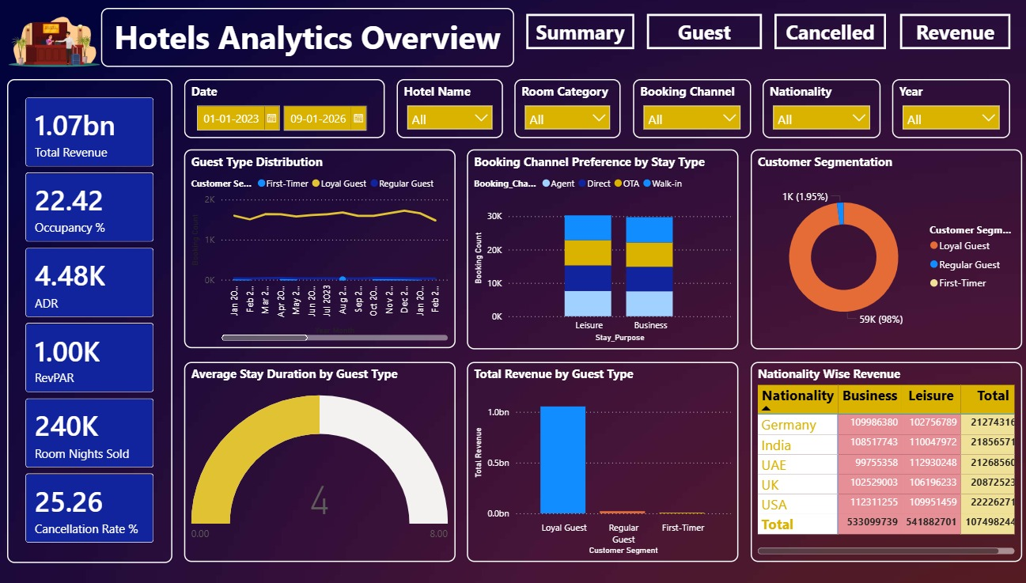
GUEST ANALYSIS
• Examination of guest type distribution (Business and Leisure)
• Analysis of stay purpose and booking behavior
• Evaluation of nationality-based revenue contribution
• Study of booking channel preferences
• Assessment of average stay duration
• Identification of high-value and repeat customers
Loyal guests contribute the highest revenue and form the largest segment.
Direct and OTA channels are preferred across Business and Leisure bookings.
Occupancy and ADR together drive strong RevPAR performance.
INSIGHTS

Slide 13
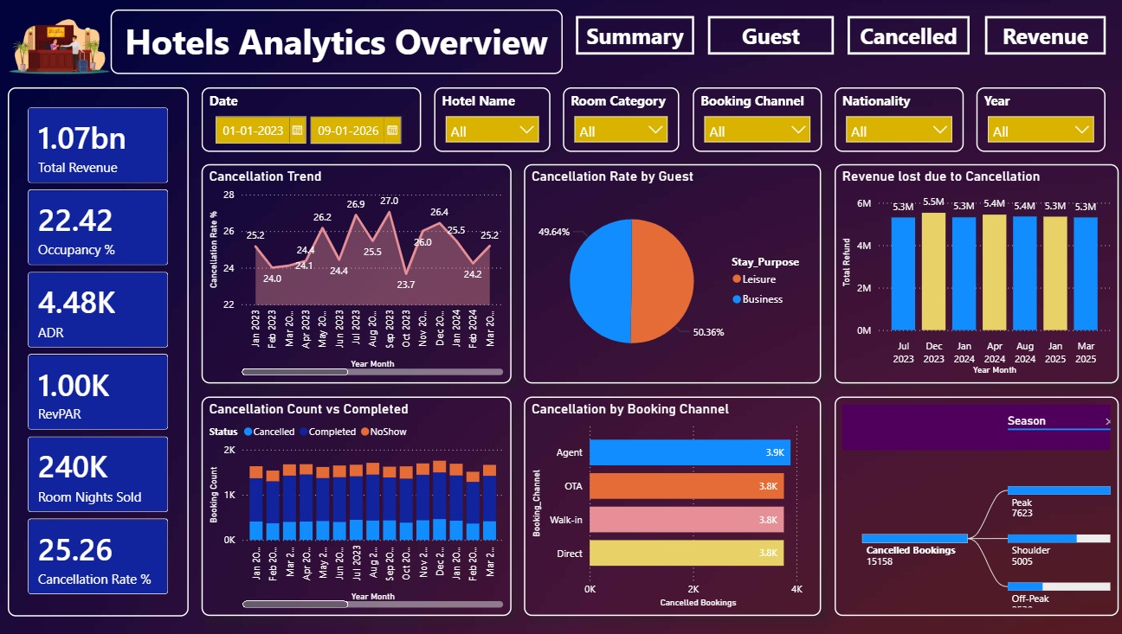
FORECASTING AND CANCELLATION TRENDS
• Monitoring cancellation rate and booking reliability
• Analysis of revenue loss due to cancellations
• Identification of seasonal cancellation patterns
• Evaluation of channel-based cancellation risks
• Study of booking status distribution
• Supports proactive revenue risk management
Cancellation rate remains high, affecting occupancy stability.
Revenue loss due to cancellations is consistent across months.
Peak season shows higher cancellation volume.
INSIGHTS

Slide 14
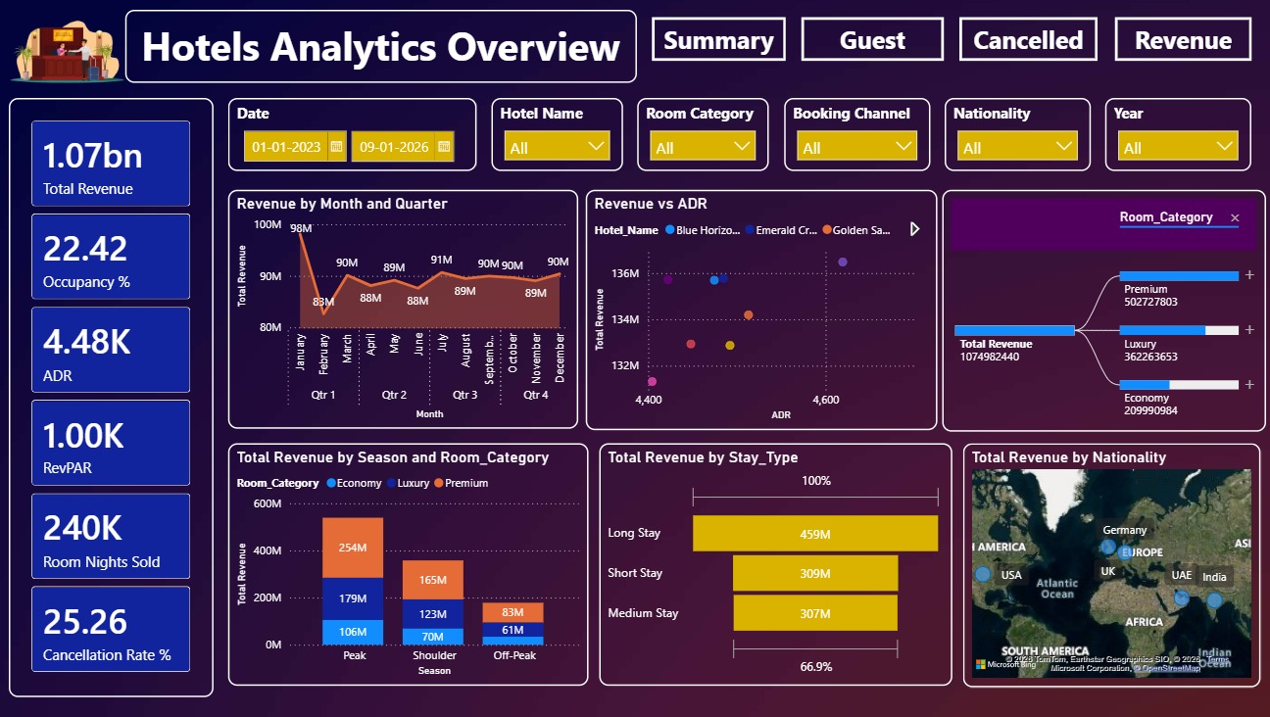
REVENUE STRATEGY DASHBOARD
• Consolidated view of total revenue performance
• Comparison of ADR and RevPAR for pricing insights
• Seasonal and geographic revenue distribution analysis
• Evaluation of room category contribution
• Booking channel performance assessment
• Enables strategic planning and decision-making
Higher ADR positively impacts total revenue.
Peak season and premium rooms generate maximum revenue.
Long-stay bookings contribute significantly to profitability.
INSIGHTS

Slide 15
CONCLUSION
From this project were able to clearly analyze the overall hotel revenue performance and identify key business insights. Through this dashboard, we understood occupancy trends, pricing effectiveness using ADR and RevPAR, and the impact of cancellations on revenue. We also identified high-performing booking channels, seasonal revenue patterns, and valuable customer segments contributing the most to profitability. The analysis helped highlight areas where revenue leakage occurs and where pricing strategies can be improved. Overall, this dashboard provides a clear, data-driven foundation for strategic decision-making, helping hotel management optimize revenue, reduce losses, and improve operational efficiency.
FUTURE ENCHANCEMENTS
Implement AI-based revenue and occupancy forecasting
Develop dynamic pricing recommendation system
Integrate real-time booking data from live systems
Add advanced customer segmentation and loyalty analysis

Slide 16
THANK YOU

